Slide 1
Different Distance Based Classification techniques on IRIS Data set https://archive.ics.uci.edu/ml/datasets.php
UCI Machine Learning Repository: Data Set Description
No of Classes | No of Features | No of observation of each class
Setosa Versicolour Virginica | sepal length sepal width petal length petal width | C -1: 50 C -2: 50 C-3: 50
Training Set: 80% of Each class instances
Testing Set: 20% of each class Instances

Slide 2
Distance Metrics
Euclidean Distance (Squared ED, Normalized Square ED)
City Block Distance (=Manhattan Distance)
Chess Board Distance
Mahalanobis Distance
Minkowski Distance
Chebyshev Distance
Correlation Distance
Cosine Distance
Bray-Curtis Distance
Canberra Distance

Slide 3
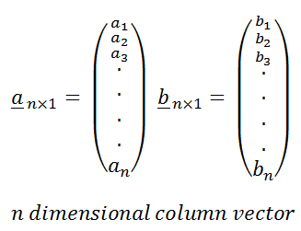
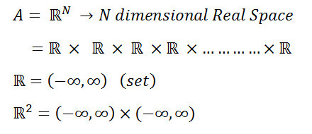
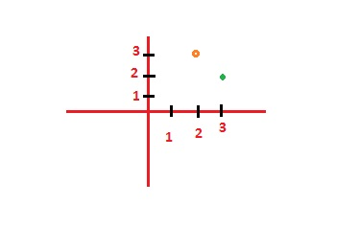
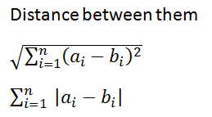

Vector Representation
2D Euclidean Space

Slide 4
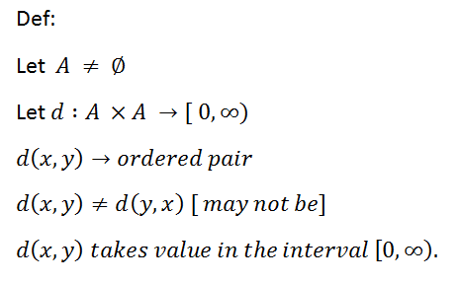
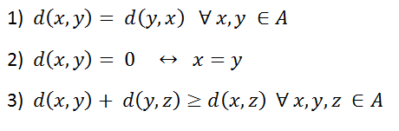
Properties of Metric
Triangular
Inequality
1). Distance is not negative number.
2) . Distance can be zero or greater than zero.

Slide 5
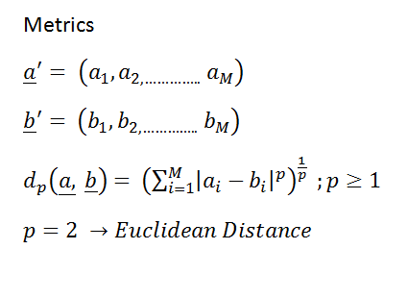
Dissimilarity Measures

Slide 6

Classification Approaches
Generalized Distance Metric
Step 1: Find the average between all the points in training class C_{k} .
Step 2: Repeat this process for all the class k
Step 3: Find the Euclidean distance/City Block/ Chess Board between Centroid of each training classes and all the samples of the test class using
Step 4: Find the class with minimum distance.

Slide 7
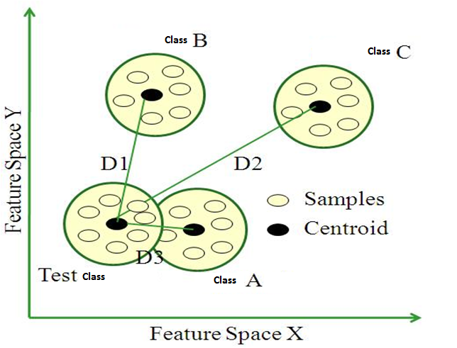
Euclidean Metric Measurement

Slide 8
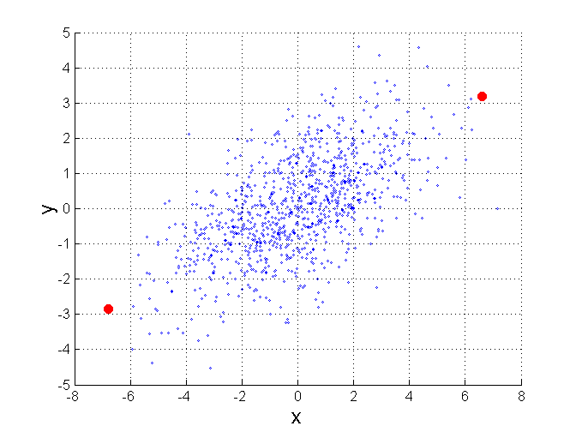
Mahalanobis Distance
Σ is the covariance matrix of the input data X
B
When the covariance matrix is identity
Matrix, the mahalanobis distance is the
same as the Euclidean distance.
Useful for detecting outliers.
A
P
For red points, the Euclidean distance is 14.7, Mahalanobis distance is 6.

Slide 9
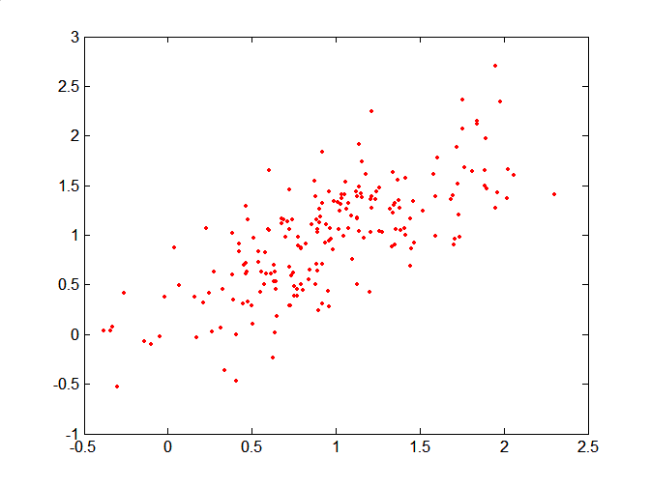
Mahalanobis Distance
Covariance Matrix:
C
B
A: (0.5, 0.5)
B: (0, 1)
C: (1.5, 1.5)
Mahal(A,B) = 5
Mahal(A,C) = 4
A

Slide 10
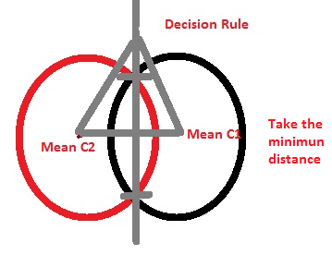
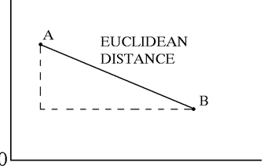
Geometric Representations of Euclidean Distance

Slide 11
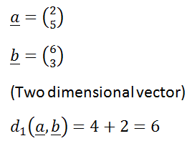
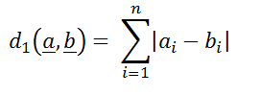
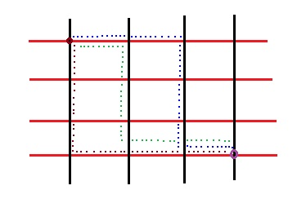
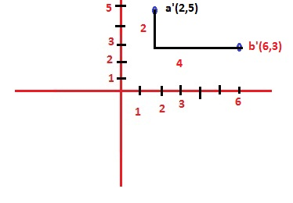
City Block Distance
City Block Distance

Slide 12
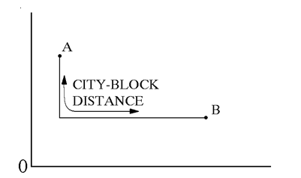

Geometric Representations of City Block Distance
City-block distance (= Manhattan distance)
The dotted lines in the figure are the distances (a₁-b₁), (a₂-b₂), (a₃-b₃), (a₄-b₄) and (a₅-b₅)

Slide 13
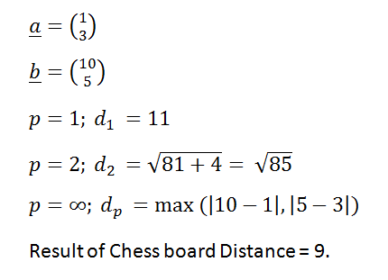
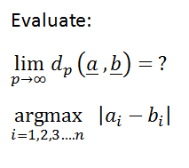
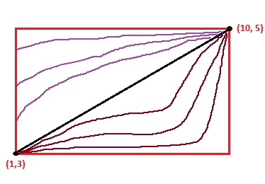
Chess Board Distance
Euclidean Distance
City Block Distance
Chess Board Distance

Slide 14
Correlation Distance
Correlation Distance [u, v]. Gives the correlation coefficient distance between vectors u and v.
Correlation Distance [{a, b, c}, {x, y, z}]; u = {a, b, c};
v = {x, y, z};
CD = 1 - (u – Mean [u]).(v – Mean [v]) / (Norm[u - Mean[u]] Norm[v - Mean[v]])

Slide 15
Cosine Distance
Cosine distance [u, v]; Gives the angular cosine distance between vectors u and v.
Cosine distance between two vectors:
Cosine Distance [{a, b, c}, {x, y, z}]
CoD = 1 - {a, b, c}.{x, y, z}/(Norm[{a, b, c}] Norm[{x, y, z}])

Slide 16
Bray Curtis Distance
Bray Curtis Distance [u, v]; Gives the Bray-Curtis distance between vectors u and v.
Bray-Curtis distance between two vectors:
Bray-Curtis Distance[{a, b, c}, {x, y, z}]
BCD: Total[Abs[{a, b, c} - {x, y, z}]]/Total[Abs[{a, b, c} + {x, y, z}]]

Slide 17
Canberra Distance
Canberra Distance[u, v] Gives the Canberra distance between vectors u and v.
Canberra distance between two vectors:
Canberra Distance[{a, b, c}, {x, y, z}]
CAD: Total[Abs[{a, b, c} - {x, y, z}]/(Abs[{a, b, c}] + Abs[{x, y, z}])]

Slide 18
Minkowski distance
The Minkowski distance can be considered as a generalization of both the Euclidean distance and the Manhattan Distance.

Slide 19
Output to be shown
Error Plot (Classifier Vs Misclassification error rates)
MER = 1 – (no of samples correctly classified)/(Total no of test samples)
Compute mean error, mean squared error (mse), mean absolute error

